Slide 1
How Bitcoin Works Under the Hood
Notes:
Own, Send, Mine bitcoins

Slide 2
TODO
How transaction is done
How to transfer
RSA
Bitcoin cryptography
HASH 256
To understand: blockchain.info
Youtube: blockchain.info

Slide 3
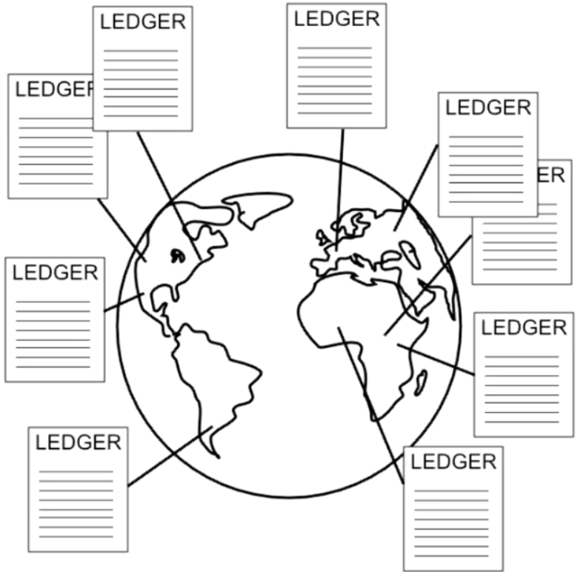
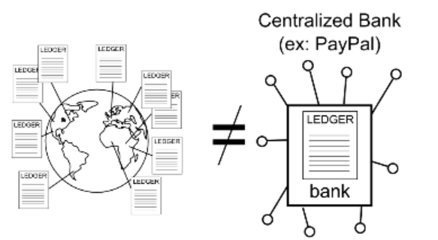
What is Bitcoin
Ledger
Alice | 5.4
Bob | 100
Frank | 700
Carlos | 0.0000001
… | 1

Slide 4
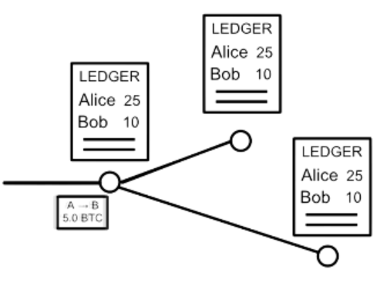
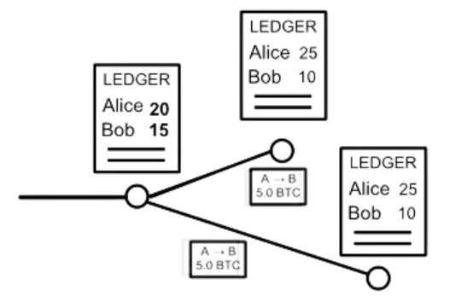
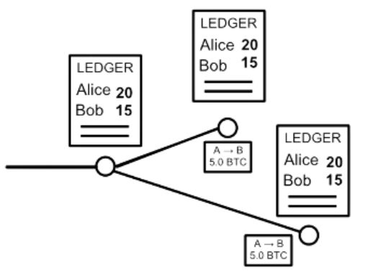
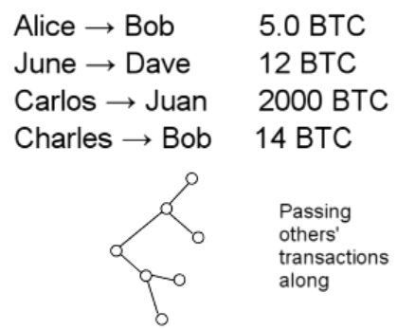
Sending Money
Alice → Bob 5.0 BTC

Slide 5
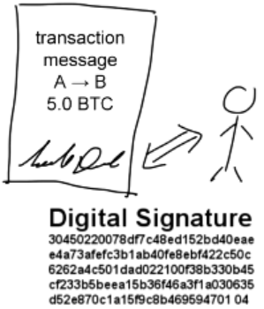
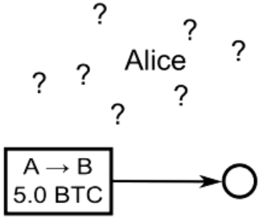
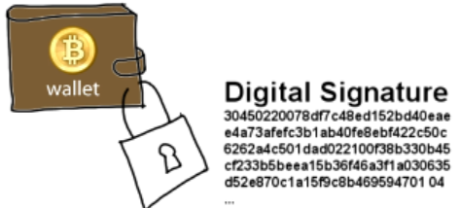
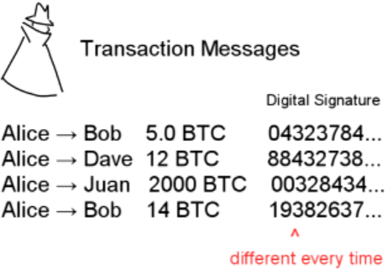
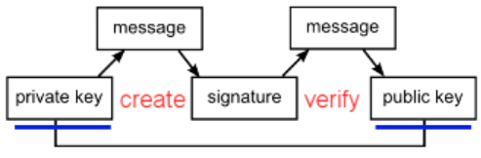
Sending Money & Authentication
Signature = f(message, private key)
1=? V(message, public key, signature)
Notes:
Think as:
Private key: true password,
Signature: intermediary proves having the password, without reveal it.
Public key: send to address in BTC

Slide 6
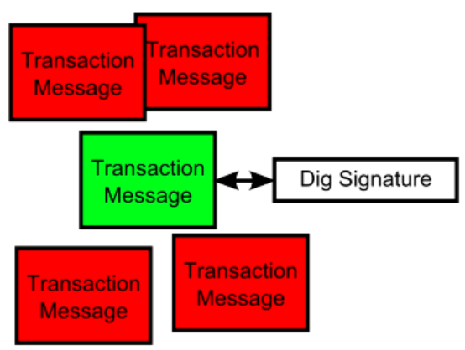
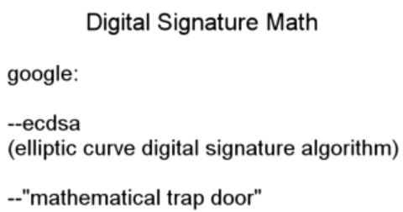
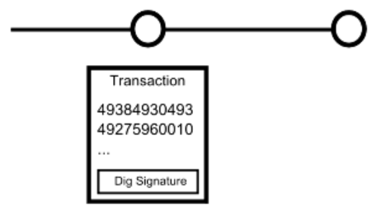
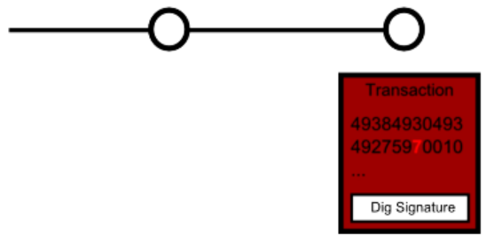
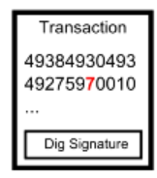
Digital Signature

Slide 7
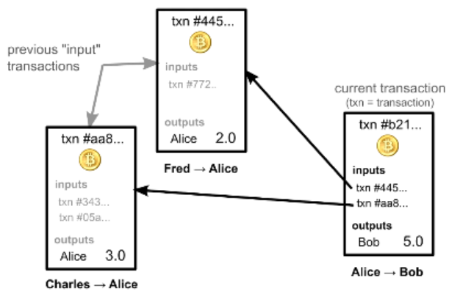
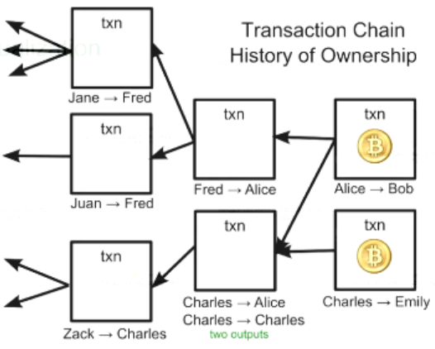
Account Balances
Ownership via previous transactions
Check previous transactions ~ 24h
Blockchain.info

Slide 8
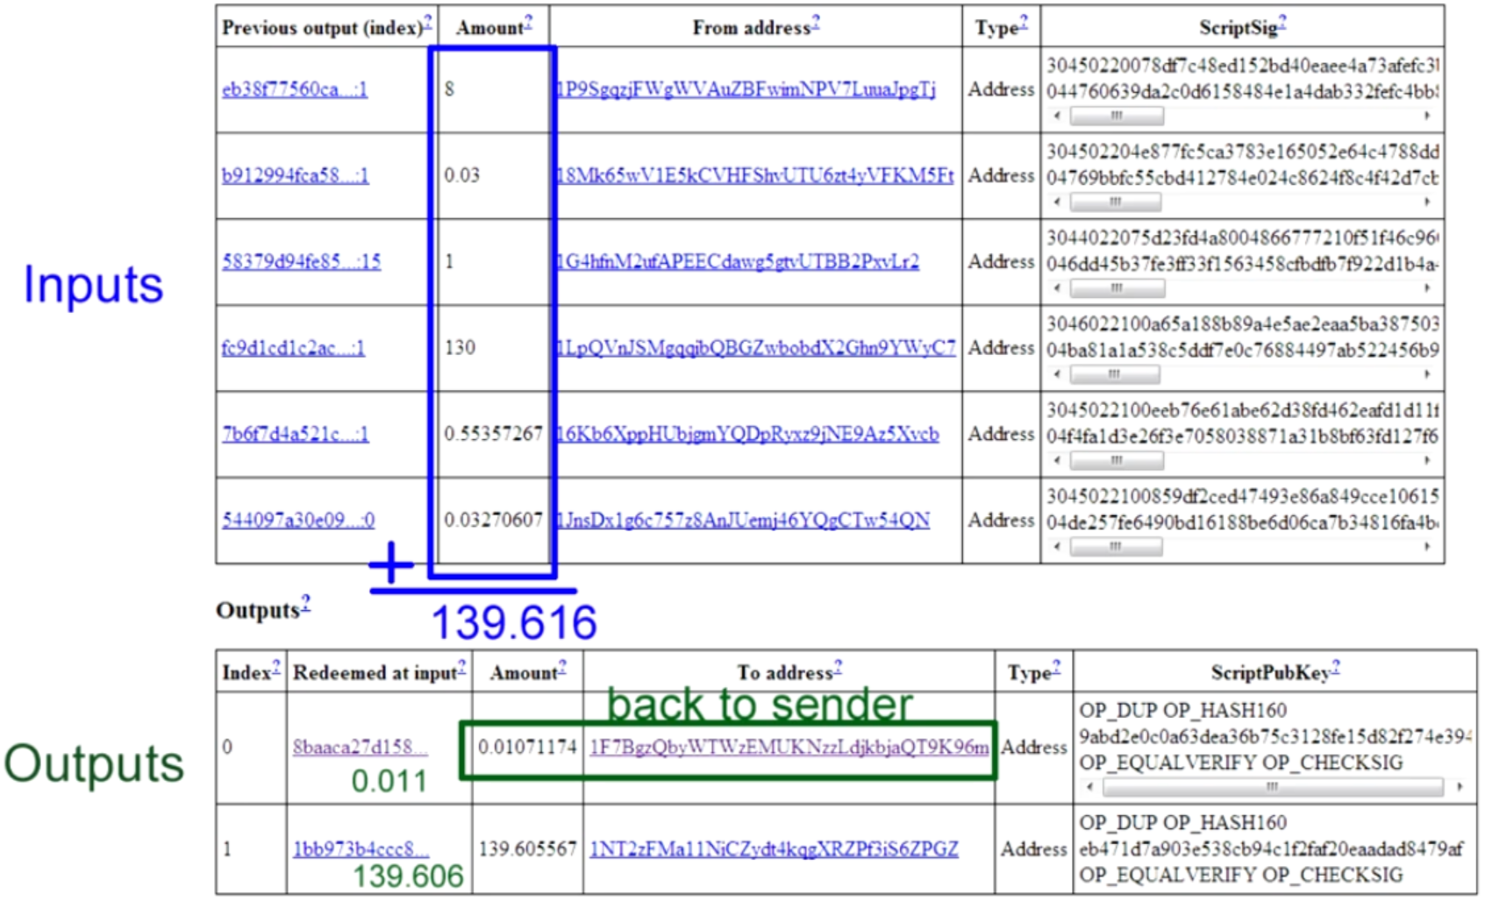
Real Transactions

Slide 9
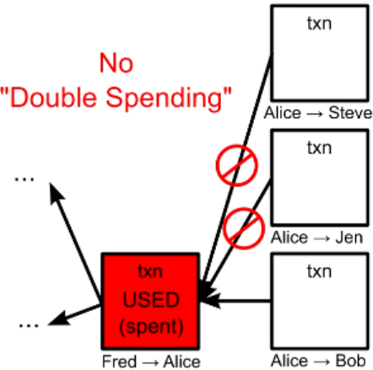
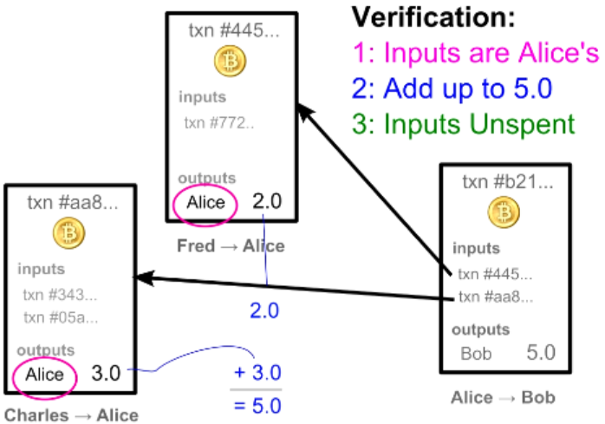
Transaction Verification
Each Transaction Can Only be Used Once as an input

Slide 10

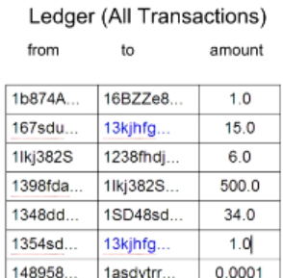
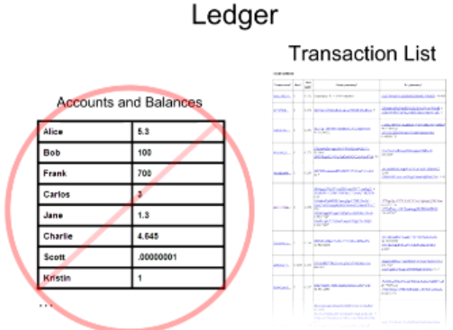
Balance Calculation
16

Slide 11
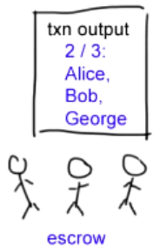
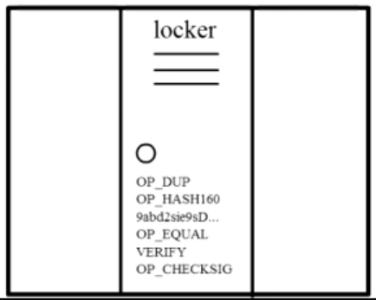
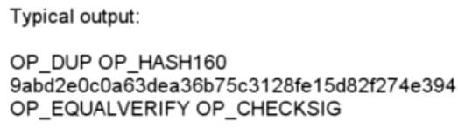
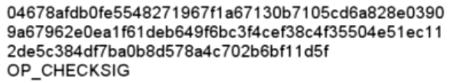
Complex Transactions: Mathematical Puzzles
Transactions: Mathematical Puzzles with locker
Defined with special Scripting language
Only owner can solve it
Support more complex conditions
First Transaction: 2009, Jan 3, 50BTC

Slide 12
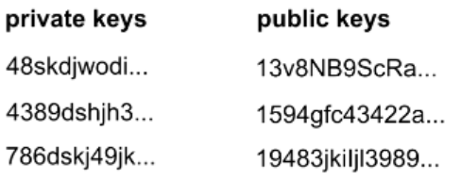
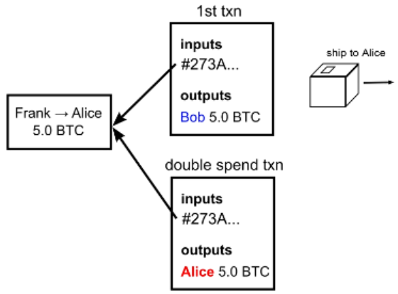
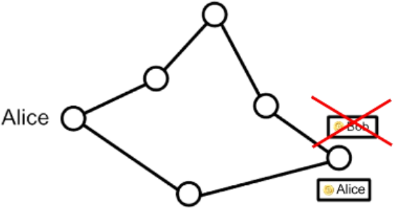
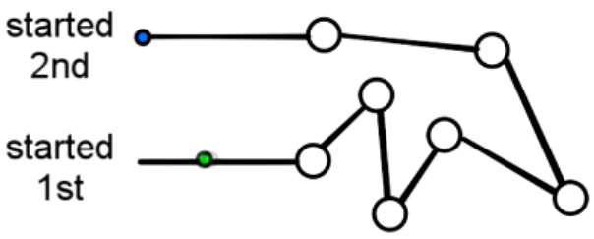
Transaction Security
Wallet
Anonymity
Possible bitcoin address: 2^160
Bitcoin transaction Security:
Digital Signatures
Referenced Transactions
Security Hole: Transaction Order
Double Spending Fraud
Nodes need to agree on transaction order

Slide 13
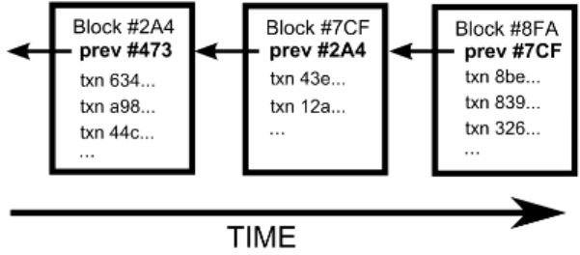
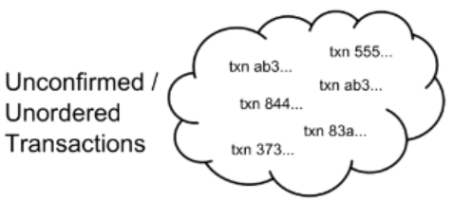
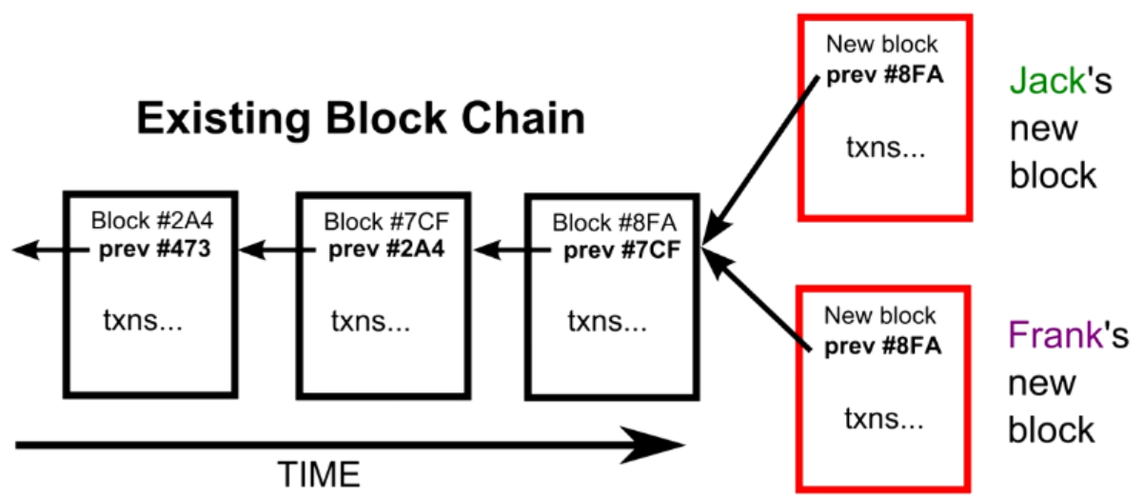
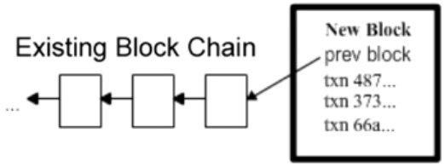
Block Chain
The Block Chain: Ordering Solution
Transaction Chain: History of Ownership
Unconfirmed Transactions
Add to new Block
Potential next blocks

Slide 14
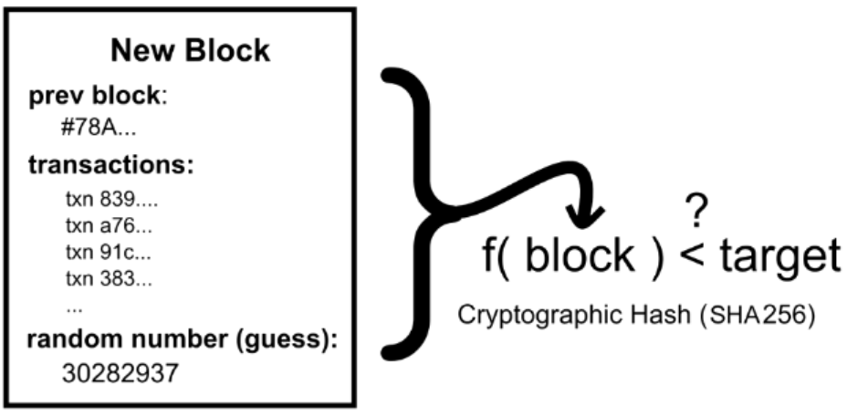
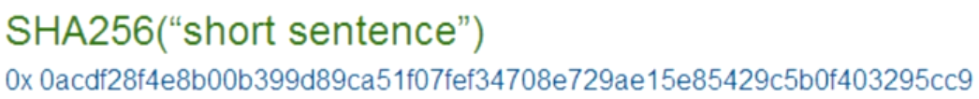
Cryptographic
Block Puzzle
Block Puzzle: SHA256

Slide 15
Sending Money & Authentication
Alice → Bob 5.0 BTC

Slide 16
Lose money

